Slide 1


Presentation on
Expection Handling
Presented by :
D. kaveri
Batch no : 533

Slide 2
About me
My name is kaveri. I have completed my B.Tech in Computer Science and Engineering .
I am interested in Data Science because it combines my passion for problem-solving and working with data. I like finding patterns in data and using them to make better decisions.
GitHub : https://github.com/kaverid844-prog
LinkedIn : linkedin.com/in/dumpali-kaveri-6915b72b9

Slide 3
Agenda
Objective of the Exception handling
What is Exception Handling
Difference Between error and Exception
Common bult-in Exception
Ways of Handling Exception
Real-world Application
Advantages
Conclusion

Slide 4
Objectives of Exception Handling
To Understand the concept of exception handling
To Identify different types of errors and exceptions
To Learn how to handle runtime error using exception handling techniques.
To Manage exception using try, except, else and finally.
To Learn when and why exception occur.

Slide 5
What is Exception Handling?
Exception handling is a mechanism in Python used to handle runtime errors so that the program can continue executing without crashing.

Slide 6
Difference between Error and Exception
Error | Exception
An error is a problem that prevents the program from running correctly. | An exception is a runtime error that occurs during program execution.
Caused by coding mistakes. | caused by user input or runtime conditions.
Stops the program. | can be handled using try and except blocks.
Example: SyntaxError, IndentationError | Example: ValueError, ZeroDivisionError

Slide 7
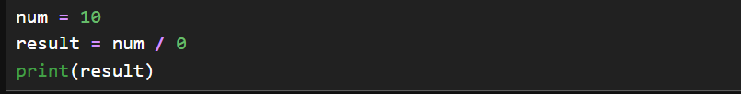
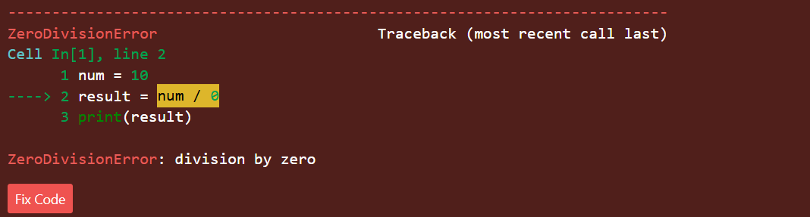
Common built-in Exceptions in Python
ZeroDivisionError : : A ZeroDivisionError occurs when a program tries to divide a number by zero. Since division by zero is mathematically undefined, Python raises this error.
Example

Slide 8

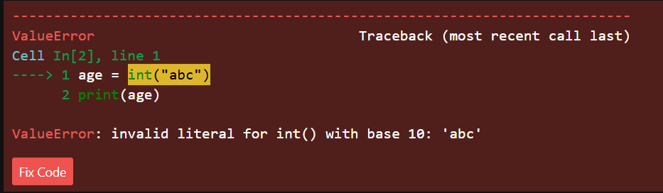
ValueError : A ValueError occurs when the correct data type is used, but the value is invalid.
Example

Slide 9
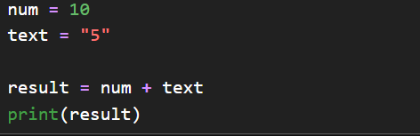
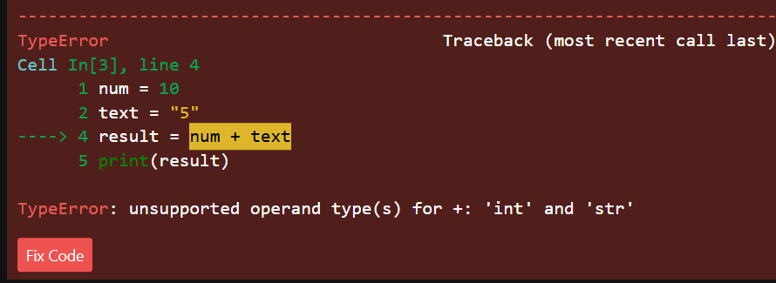
TypeError :A TypeError occurs when an operation or function is performed on a value of the wrong data type.
Example :

Slide 10

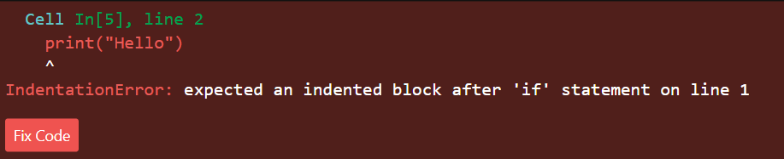
IndentationError : Indentation is used to define code blocks in Python. If indentation is missing or incorrect, Python raises an IndentationError and stops execution.
Example

Slide 11
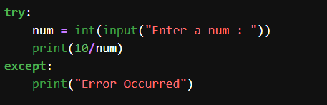

Ways of Handling Exception
Try-Except
Handles runtime errors
Prevents program crash
Executes except block if error occur
Example :
Output :

Slide 12
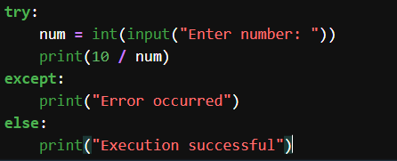

Try-Except-Else
Executes only if no error occurs
Used for success logic
Example :
Output :

Slide 13
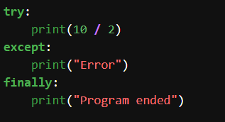

Try-Except-Finally
Always executes
Used for cleanup tasks
Runs whether error occurs or not
Example :
Output :

Slide 14
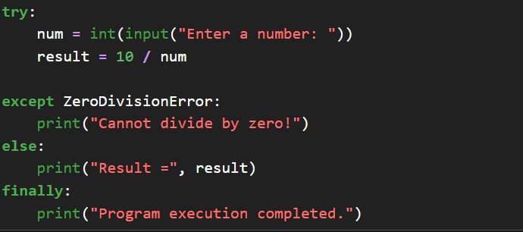
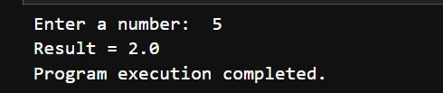
Try-Except-Else-Finally
Example

Slide 15
Real-world applications
ATM systems
Payment apps
Login systems

Slide 16
Advantages
Prevents crashes
Improves user experience
Makes code reliable
Easier debugging

Slide 17
Learning Outcomes and Challenges
Understand the concept of exceptions and errors in Python.
Identify common exceptions such as ZeroDivisionError, ValueError, TypeError, and IndentationError.
Use try, except, else, and finally blocks effectively.
Understanding the difference between errors and exceptions.
Choosing the correct exception type to handle.

Slide 18
Conclusion
Errors are unavoidable
Handling them is essential
Makes programs professional
To conclude, errors are unavoidable in programming, but handling them properly makes our programs strong and efficient.

Slide 19
Any Queries???

Slide 20

THANK YOU

